Slide 1
Strategic Review:
Wireless Technologies & Opportunities
Greg Hadlock
July 7, 2004

Slide 2
Agenda
Table of Contents
Executive Summary
Wireless Market Opportunities
  DIA and Transport VIA Wireless
  Point-to-Point Wireless
  Point-to-Multipoint Wireless (Fixed Wireless)
  Other Market Opportunities

Slide 3
Executive Summary
Objective
To evaluate the wireless market opportunities and supporting technologies to recommend the potential roles in which Progress Telecom might participate in the wireless sector.
  Evaluation of market opportunities to leverage wireless technologies
  Strategic fit with existing services portfolio and network infrastructure
  Develop business case

Slide 4
Point to Point Wireless Opportunity
Deployment of point-to-point wireless technologies to extend network presence
  Services ranging from 1Mbps through 1.42Gbps
  Ranges from 1 mile to 25+miles
New Revenue Opportunities
  Service to near-net locations using wireless extension
  Wireless Backhaul opportunity for cellular carriers
Improved Speed to market
  Rapid deployment
  Reduced CAPEX vs. fiber build
  No recurring local loop costs

Slide 5
Point to Point Customer Opportunities
Customer Base | Application
Existing Customers | Private Point-to-Point networks (currently off-net) Temporary Bandwidth (e.g. special events) Backup / Failover for existing services Additional service locations
Cellular Providers | Cellular Backhaul from existing towers Native mode Ethernet connectivity for next-gen networks
Enterprise Customers | T-1, DS-3, Ethernet, and IP Services delivered to customer premises Delivery mechanism for VOIP offering
Multi-unit dwellings | Wholesale delivery of Internet Access, potentially VOIP
Level 3 | Wireless extension of backbone network Near-net locations added as service locations! Emergency restoration for critical locations / customers

Slide 6
Point to Point Wireless Technologies
Vendor | Product | Frequency Band (Ghz) | Throughput (Mbps) | Reach (Miles) | Link Cost
Motorola | Canopy 20 | 2.4 / 5.2 / 5.7 | 14 (half duplex) | 15-20 | $4k
Alvarion | BreezenetB | 5.8 | 28 (quasi full) | 15-20 | $4-7k
Orthogon | Spectra | 2.4 / 5.2 / 5.7 | 100(half duplex) | 10-15 | $12k
Aeras | Wavelink – 4500 | 5.2 / 5.7 | 45 (full duplex) | 10 to 15 | $12k
Dragon-wave | AirPair 100 | 18 / 23 | 100 (full duplex) | 4 to 7 | $28k to $33K
Proxim | Tsunami 45 | 5.2 / 5.7 / 23 | 45 (full duplex) | Up to 15 | $38k
Ceragon | Fiber Air | 6/11/18/23/38 | 400-800 (full) | 15-30 | $24k

Slide 7
Canopy Point to Point Wireless Technologies
Wireless Technologies
  Motorola Canopy Backhaul
  Wireless Ethernet Bridge
  2.4 / 5.2 / 5.8 Ghz Unlicensed Frequency bands
  7 Mbps throughput / $4k per link / Up to 20 miles
  14 Mbps throughput / $12k per link / Up to 10 miles
  Half Duplex
  Low data rate for spectrum used (bad)
  Low Frames per second

Slide 8
Alvarion Point to Point Wireless Technologies
Wireless Technologies
  Alvarion BreezenetB
  Wireless Ethernet Bridge (full vlan support)
  5.8 Ghz Unlicensed Frequency band
  28 Mbps throughput / $5k per link / 15 miles 99.99%
  Quasi Full Duplex
  Good use of spectrum
  High frame/s rate
  Needs a high signal to noise ratio
  Choice of antennas

Slide 9
Aeras Point to Point Wireless Technologies
Wireless Technologies (cont.)
  Aeras Wavelink 4500
  Good use of spectrum
  Wireless Point-to-point Ethernet / DS3 (Software Selectable)
  5.3 / 5.8 Ghz unlicensed bands
  45 Mb/s Throughput (All or nothing)
  Ethernet Wayside Channel (1 to 2 Meg)
  7 to 10 miles with 2 to 3 ft antenna (99.99%)
  1 to 5 miles with integrated antenna
  $12k link cost

Slide 10
Dragonwave Point to Point Wireless Technologies
Wireless Technologies (cont.)
  Dragonwave AirPair 100
  100 Mbps throughput, full duplex
  18 Ghz Band 7 to 15 miles licensed 99.99%
  23 Ghz Band 7 miles licensed 99.99%
  2k to 2.5k per license
  $28k for 4 mile link
  $33k for 7.5 mile link
  Licensed links protect from interference
  Carrier Grade radios

Slide 11
Proxim Point to Point Wireless Technologies
Wireless Technologies (cont.)
  Proxim
  Tsunami 45 / 100
  45 / 100 Mbps actual throughput, full duplex
  Includes 1 or 2 T1 links for T1 replacement
  $50k for 100 Mbps link
  $38k for 45 Mbps link
  Several licensed and unlicensed frequency bands
  15 Mile link for 5.8Ghz band, 7 miles for other bands

Slide 12
Ceragon Point to Point Wireless Technologies
Wireless Technologies (cont.)
  Ceragon Fiberair
  400 Mbps throughput, full duplex up gradeabale to 800 Mbps
  Varity of licensed band from 6/7/11/18/23/38 Ghz
  Link distances up to 30 miles in low bands 99.99%
  2k to 2.5k per license
  $26k for a 400 Mbps 18 GHz link
  40k for 25 mile 200 Mbps link
  Carrier Grade radios

Slide 13
Next Steps- Point to Point Wireless
Evaluate Vendor Technologies (100+ vendors)
  Financially sound company
  Comprehensive product set
    Low cost, low speed point to point
    High speed point to point
    Native Ethernet (Transparent) and TDM offerings
  Common management platform across product set
  Carrier Grade Reliability
  Can be monitored with existing infrastructure
Compile Preliminary Business Case for service delivery
Lab / Field trial of leading technologies

Slide 14
Fixed Wireless Opportunities
Deployment of Fixed Wireless Technologies to create an ‘umbrella’ over a service territory
  Cell Bandwidth up to 38Mb/s
  Reach up to 7 miles
  Native Ethernet Handoff
Fixed Wireless Enables New Customers & Services
  Wholesale infrastructure for low speed data services (<4Mb/s)
  Wireless Based T-1, Ethernet transport (MPLS)
  Retail opportunity for Level 3 or subsidiary for consumer broadband
  Broad access to enterprise and consumer markets
  Aggregation method for VOIP Peering Initiative
  Replacement for costly frame relay circuits

Slide 15
Fixed Wireless Opportunities (PTMP)
Customer Base | Application
Existing Customers | Additional near-net locations at low speeds Campus and Virtual Campus Networking
ILEC/CLEC/ISP/Cable Co | Extension of ADSL and Cable Modem networks Broadband Access in Rural Areas T-1 resale for business, SOHO WiFi Hotspot Backhaul Bulk DIA and transport
Enterprise Customers | T-1 services (ILEC replacement) Ethernet, DIA, and VOIP package Virtual Private Network between facilities Electronic Billboard control (advertising)
Government Agencies Homeland Security Police Public Safety DOT | Video Surveillance Traffic Monitoring & Control Electronic Information Sign Control Security Monitoring Multi-agency connectivity

Slide 16
Fixed Wireless Opportunities (PTMP)
Customer Base | Application
Utilities Electric Gas Water | Remote meter reading Load Control Time of day billing Demand forecasting Remote locates Security Monitoring (residential / business) Remote diagnostics / trouble shooting

Slide 17
Benefits and Challenges- Fixed Wireless
Benefits
  Low Deployment Costs
  Low Cost Incremental Growth
  Reduced Deployment Timeframes
  Reduced Delivery Times
  Increased Price/Performance Ratios
Challenges
  System Design and Installation
  Interference Mitigation
  Scalability and Reliability

Slide 18
Current Wireless Network In Orlando
Level 3’s current Orlando network is built on the canopy 5 GHz Platform.
-Serves mostly small business and residential customers via resellers
- Speeds of up to 4 Mbit/s per sector
- End user coverage area of ~600 sq Miles
Pros:
The canopy gear is well suited to a small WISP type operation
- Easy to deploy
- Reasonably priced compared to other gear
- Works well 99% of the time
Cons:
The canopy gear is not well suited for VoIP or high bandwidth transport
- Low Frame rate
- Poor utilization of spectrum
- Works well 99% of the time

Slide 19
Current Network Diagram

Slide 20
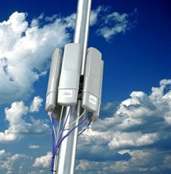
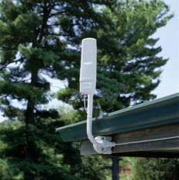
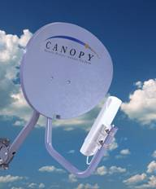

Motorola Canopy- Current network
Motorola Canopy System Main Components
Access Point (AP)
Subscriber Module (SM)
Backhaul Module (BH)

Slide 21
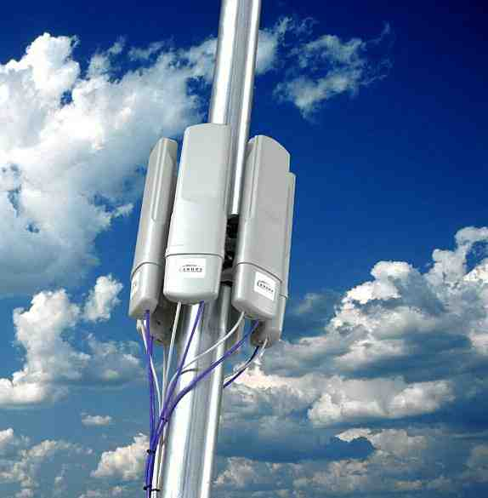
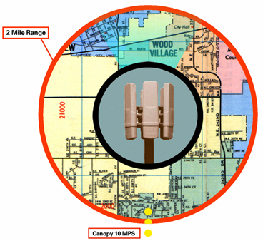
Motorola Canopy Specifications
Broadband Wireless Connectivity via an Access Point (AP) Cluster
Six AP Modules per AP Cluster each serving up to 200 Subscriber Modules (SM) each sharing 4 Mbit
Canopy Point-to-Point Systems
  Available in 2.4, 5.2 & 5.7 GHz
  15 Mile Range
  Aggregate Throughput >14 Mbps
Canopy Point-to-Multipoint Systems
  Available in 900 MHz, 2.4, 5.2 & 5.7 GHz
  10 Mile Range or less
  Aggregate Throughput >6 Mbps
  4 Mbps for a Single Subscriber Module
  Not a scaleable system
15 Mile Range

Slide 22
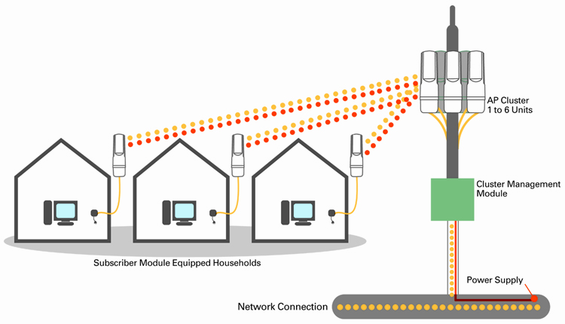
Motorola Canopy Point to Multipoint

Slide 23
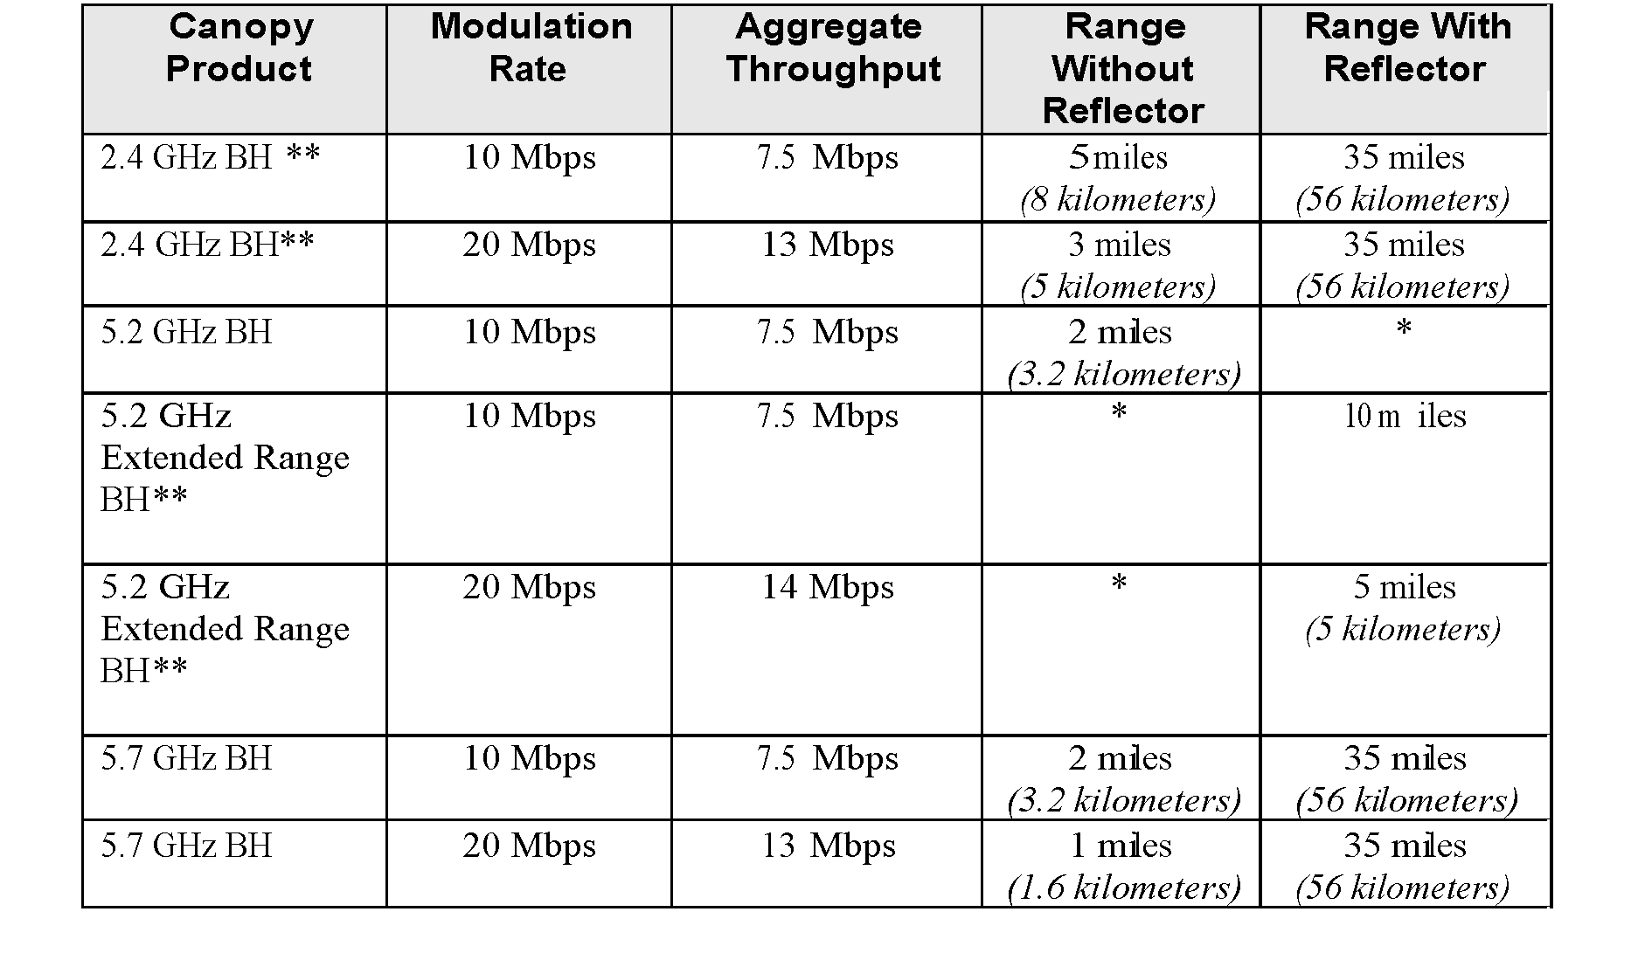
Motorola Canopy System Performance
Point to Point Range and Throughput

Slide 24
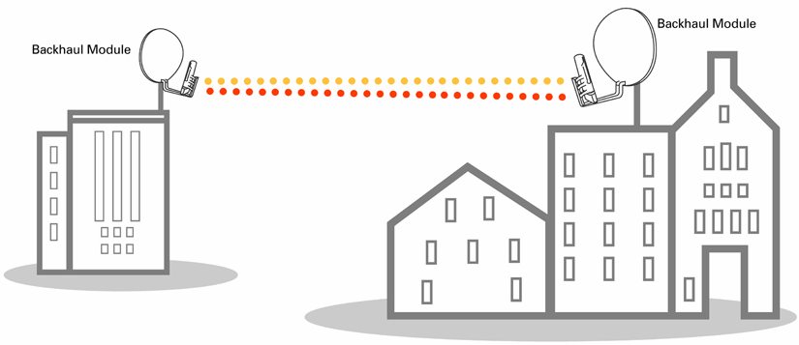
Motorola Canopy Point to Point Backhaul

Slide 25
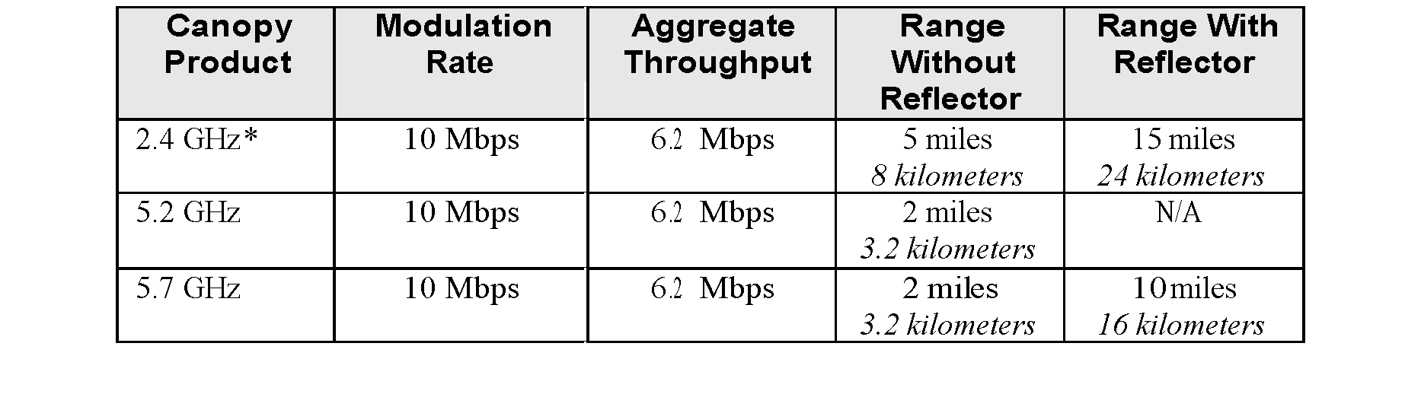
Motorola Canopy System Performance
Point to Multipoint Range and Throughput

Slide 26
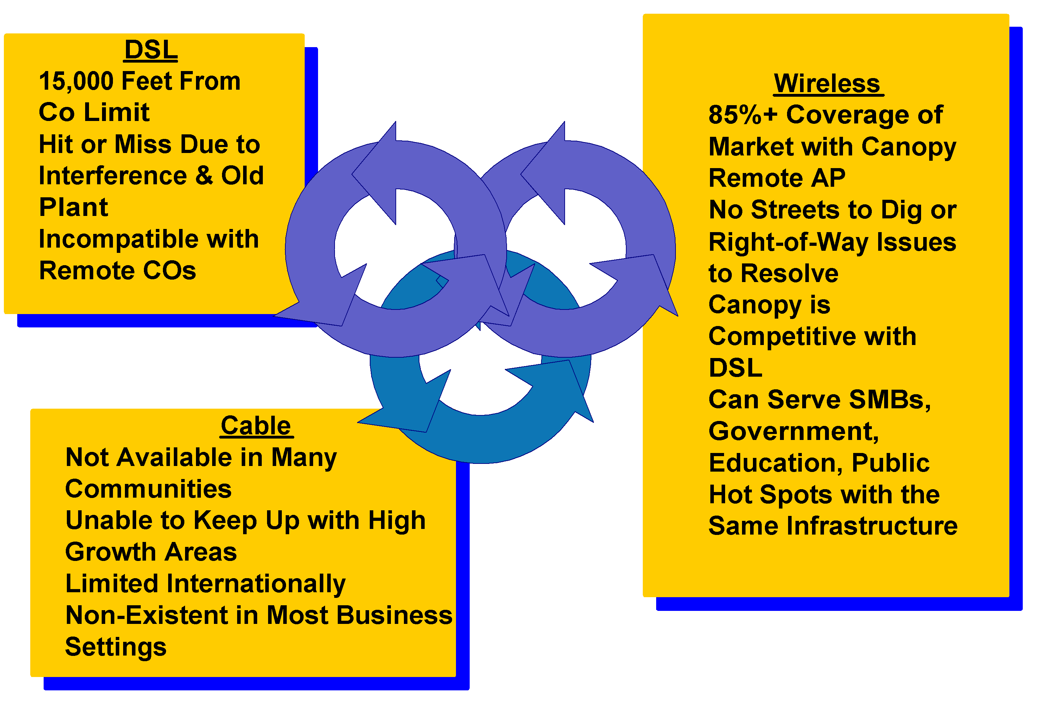
Comparison with Cable and DSL

Slide 27
Motorola Canopy System Costs
Equipment Costs- Startup w/ 10 users
Equipment Costs for each additional subscriber: $520

Slide 28
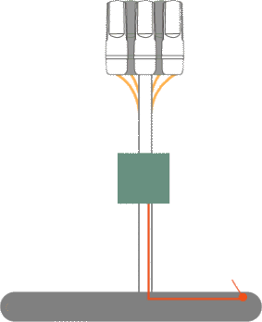
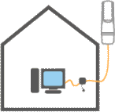
Application Example
Broadband Services in Rural Areas (Wholesale)
ISP A
Network
ISP B
Network

Slide 29
Proposed Wireless Network Design
Level 3 Metro Team has completed evaluation on various fixed wireless technologies for the metro region. These wireless technologies will enhance the capabilities and reach of the current network topology. In addition to penetrating current customer base and entering new markets for DIA and Ethernet Transport services.
The fixed wireless strategic initiative will enable the following:
  Increase Network Traffic
  Speed to Market
  Further penetration into various segments
    MDU’s
    Enterprise
    Municipalities
    Government agencies
  Fill a gap for last mile transport between bonded T1’s and oc-3 loops

Slide 30
Metro Site Scope
The architecture of the metro wireless network will be many interconnected rings forming a high speed wireless back bone.
Each site will have 3 PtMP Alvarion BreezeAccess VL, each covering 120 degrees with 38 Mbit of capacity
    The point to multi-point radios will only serve customers up to 7-10 Mbit/s
Each Site PtMP location can scale to:
    5 meg circuits – committed
    2x over subscription
    Each location : total of 16 per cell (3 cell per site) total of 48 customers
Higher bandwidth customers will receive full duplex PtP licensed radio links from our POP sites
    These licensed radios provide a dedicated full duplex circuit to the end customer
    No limit to the amount of customers served by licensed links on each location
    Leverage the existing licenses that Telcove owns
Point to Multi-Point
  Half-Duplex
  Unlicensed
  Possible use of Telcove licensed MMDS spectrum
Point to Point
  Licensed
  Full Duplex
  Preferred Band: 18 GHz for medium range hops
  Short hop band 38 GHz, 1-3 mile range

Slide 31
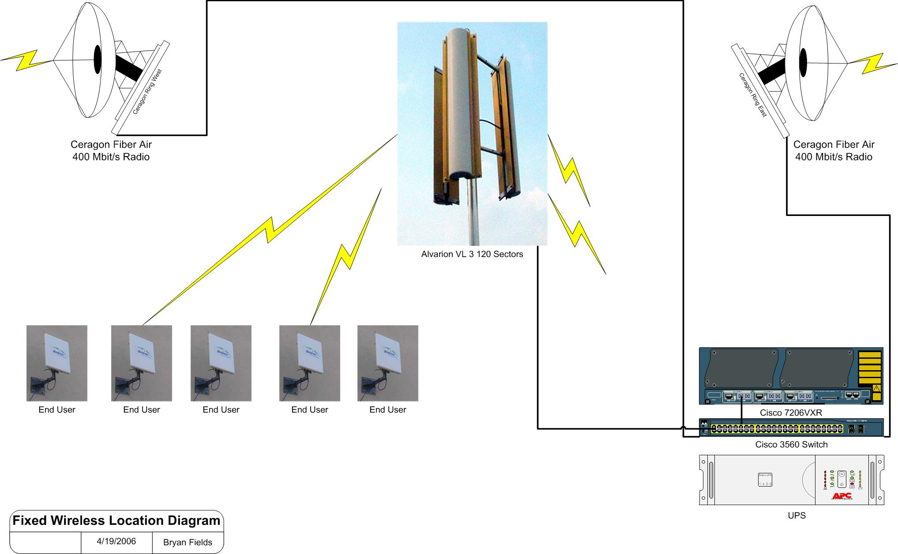
Alvarion Metro Site Diagram

Slide 32
Proposed Wireless Network Design
Equipment Costs
Cisco 7206 NPE-G1 | $15,000
Cisco 3560G-24TS | $4,000
Ceragon Link | $30,000
Alvarion Link | $7,350
UPS | $1,100
Rack | $500
Tower | $2,175
Misc hardware | $2,020
Labor Costs | $2,880
Total | $65,025
Possibly monthly gross income based on 48 PtMP customers per site:
48 customers/site | $600/MRC | $28,800

Slide 33
Next Steps- Point to Multipoint Wireless
Evaluate Vendor Technologies
  Motorola Canopy (www.motorola.com/canopy/)
    Highest carrier-to-interference ratio
    North American Market leader
    Low start up costs
    Low frame rate, high latency (10-20 ms)
    900MHz, 2.4GHz, 5.2GHz, 5.7GHz (unlicensed)
  Alvarion BreezeAccess VL (http://www.alvarion-usa.com/)
    Unlicensed and licensed product portfolio
    High Bandwidth and high frame rate, low latency (3-5ms)
    Antenna options
    Global Market Leader

Slide 34
Wireless Technology Overview
Frequency Overview
Spectrum Allocation
General Frequency Characteristics
Contributing Factors
Line of Sight vs. NLOS
Modulation Techniques

Slide 35
Spectrum Allocation
E-Band (71 GHz to 95 GHz)
100000
39 GHz PtP (38.6 Ghz to 40 GHz)
WiMax (10GHz to 66 GHz)
LMDS (27GHz to 31 GHz)
Direct Broadcast Satellite (12.2 GHz to 12.7 GHz)
10000
(10 GHz)
WiFi 802.11a (5.15 GHz to 5.35 GHz)
MMDS (2.15 GHz to 2.68 GHz)
WiFi 802.11b (2.4 GHz to 2.483 GHz)
PCS (1.85 GHz to 1.99 GHz)
1000
900 MHz ISM (902-928)
Cellular (806 MHz to 902 MHz)
(1 GHz)
3G Wireless (746 MHz to 794 MHz)
100
FM Radio (88 MHz to 108 MHz)
Broadcast TV (54 MHz to 806 MHz)
10

Slide 36
39 Ghz PtP Band
39 Ghz range is 1-3 miles for 99.99% availability
800 Mbit full duplex per channel with Ethernet and OC-48 PtP transport
Telcove owns licenses that cover 80% of USA
45 Mbit DS3 radios are ~$700 for a complete link
Affected by rain at long distances >3 Miles

Slide 37
39 Ghz PtP Band
MMDS was originally for Video services, but now for PtMP Broadband
USA is divided into 493 Basic Trading Areas, each licensee has exclusive use of 13 6MHz channels in that BTA, only operator per BTA i.e. no competion
PtMP is able to be provisioned with speeds up to 15 Mbit/s per sector
Ideal for VoIP and other highly available services
FCC protection from interference

Slide 38
General Frequency Characteristics
80
1400 Mb/s
60
1000 Mb/s
Cost ($$)
Frequency (GHz)
24
480 Mb/s
5.8
40 Mb/s
2.4
30 Mb/s
Reach (miles)

Slide 39
Link Distance by Frequency
Point-to-Point Links
Point-to-Multipoint
2.5 GHz
6 GHz
24 GHz
23 GHz
28 GHz
28 GHz
2.5 GHz
38 GHz
30.0
12
5.0 3.0
2.2
3.5
4.30
25
Reach Distance**, miles
Reach Distance*, miles
**Assume Rain Zone K, 6cm antennae for 99.995% average availability, vertical polarization.
*Assume Rain Zone K, Single Channel per Transmitter, same power, same dB gain antennae for all frequencies.

Slide 40
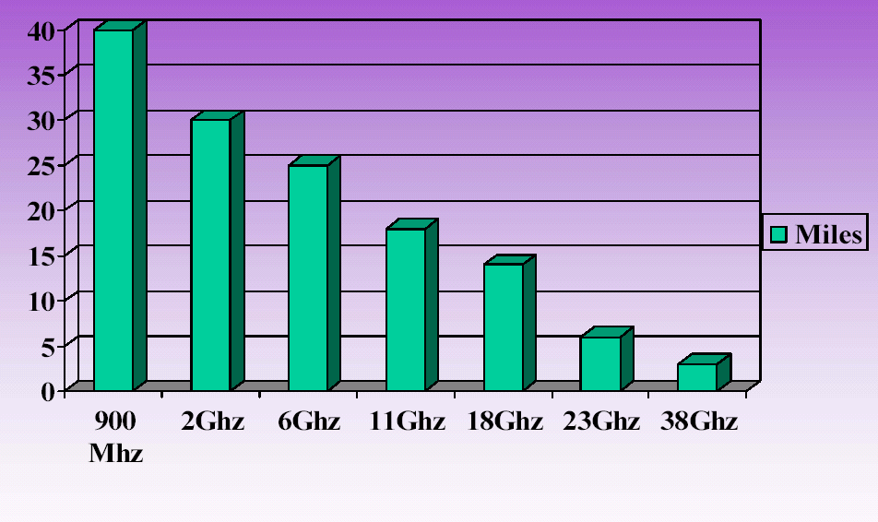
Point to Point Ranges- Licensed

Slide 41
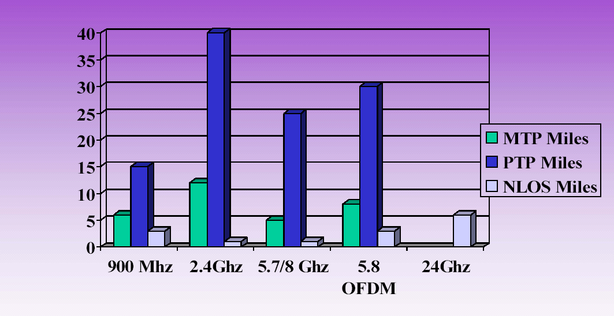
Point to Point Ranges- Unlicensed

Slide 42
Factors Affecting Wireless Links
Attenuation
  Free Space Loss
  Atmospheric Absorption
Noise
Signal Interference
Line of Sight
FCC Power Limitations

Slide 43
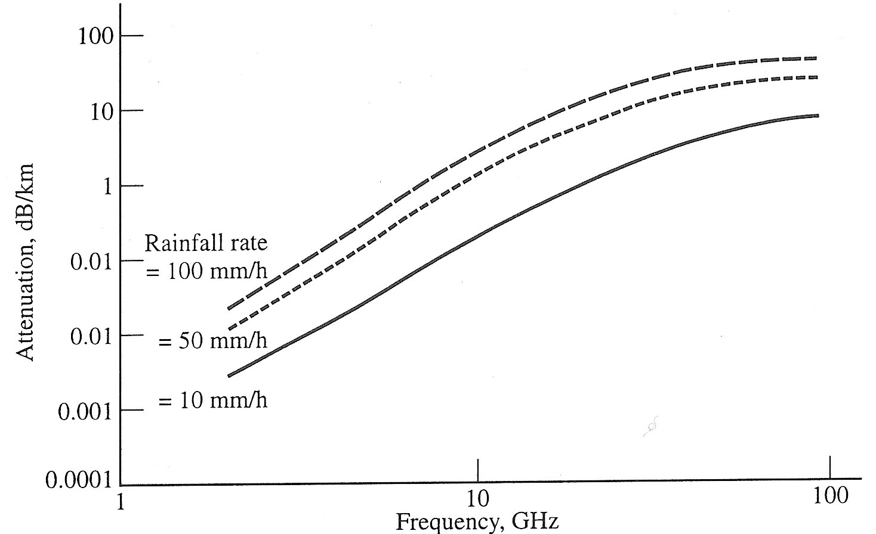
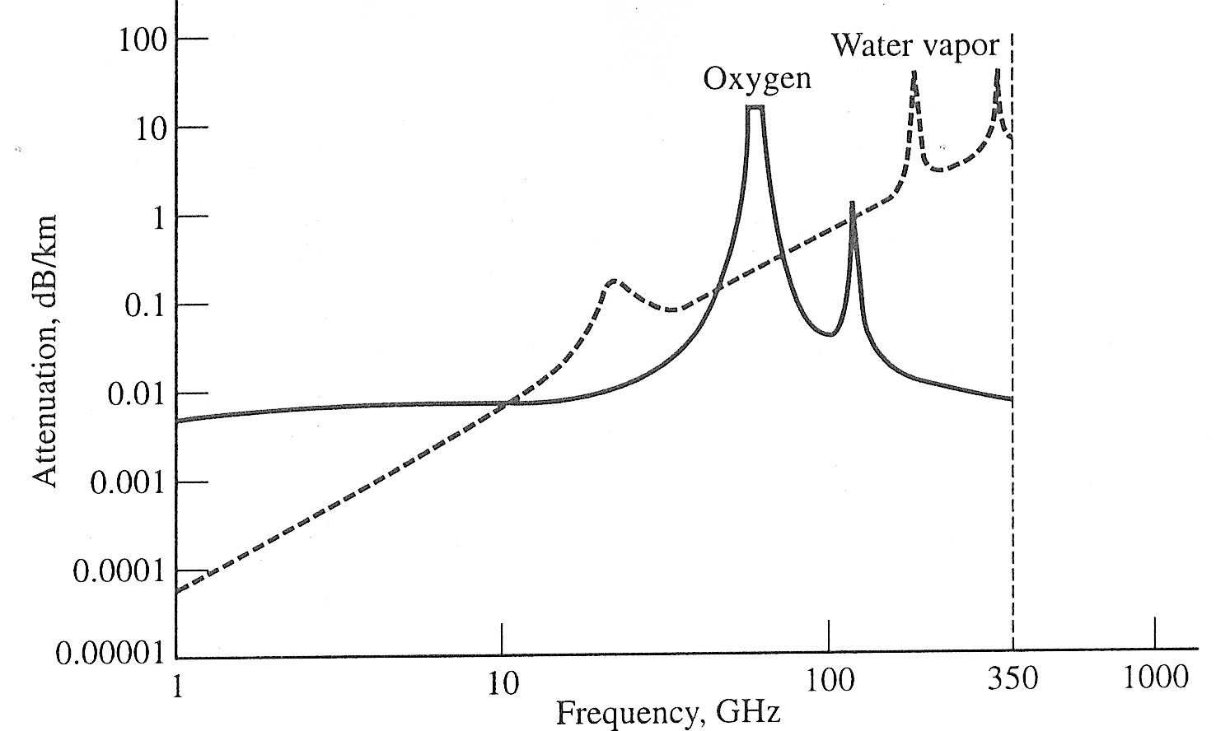
Atmospheric Interference
Atmospheric Interference:
Atmospheric Absorption
  Water Vapor Resonance at 23GHz
  Oxygen Absorption Peak at 62 GHz
Rain Interference
  Increased attenuation at higher frequencies

Slide 44
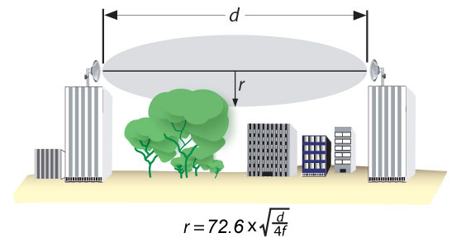
Line of Sight- Fresnel Zone
Fresnel Zone
d = distance in miles
r = radius off of the centerline in feet
f = frequency in GHz
Fresnel Zone: The area around the visual line-of-sight that radio waves spread out into after they leave the antenna. This area must be clear or else signal strength will weaken.
Typically, a wireless system will operate with up to 40% of the Fresnel zone obstructed. 60% or more of the Fresnel zone must be kept clear for reliable link operation.

Slide 45
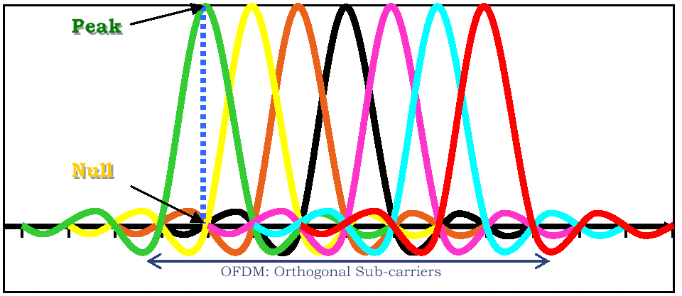
Orthogonal Frequency Division Multiplexing
Transmission of multiple frequencies within an allocated frequency range, where the frequencies are closely spaced and transmitted out of phase with each other to minimize interference.
Non Line of Sight Transmission (NLOS)
Increased efficiency of allocated spectrum
    Additional data channels
    Higher throughput

Slide 46
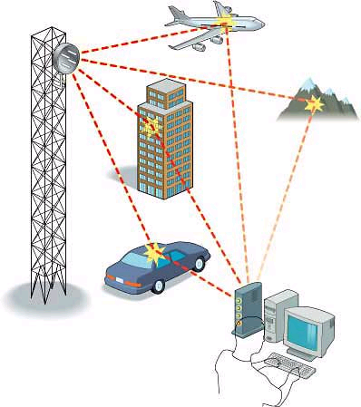
Non Line of Sight Transmission
OFDM Used to correct for multipath signal propagation to enable NLOS transmission
During ‘handshake’ process (call set-up), base station identifies multipath signals and determines relative arrival times (signal delay) and received power levels. Base station then introduces delay on shorter path(s) so that all signals received by subscriber are in-phase and complementary. Base station also adjusts transmitted power levels so that paths with higher loss are received by subscriber at acceptable receive levels.

Slide 47
Modulation of a Radio Signal
3 characteristics of transmitted signal can be varied:
  Frequency (Frequency Modulation)
  Amplitude (Amplitude Modulation)
  Phase (Phase Shift Keying)
Some modulation techniques apply multiple techniques to improve reliability or throughput

Slide 48
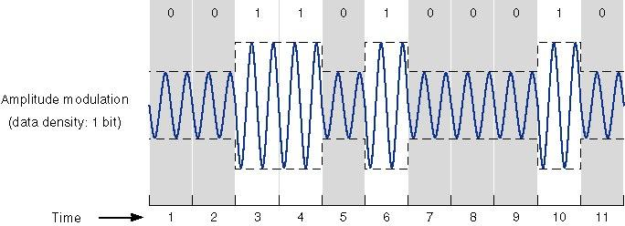
Amplitude Modulation
Values represented by different amplitudes of carrier
Usually, one amplitude is zero
  i.e. presence and absence of carrier is used
Susceptible to sudden gain changes
Inefficient

Slide 49
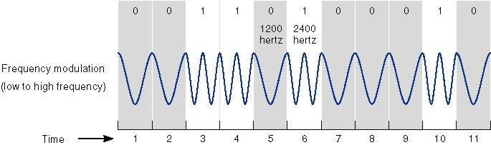
Frequency Modulation (FM)
Values represented by different frequencies (near carrier)
Less susceptible to error than ASK
Typically used up to 1200bps on voice grade lines
High frequency radio

Slide 50
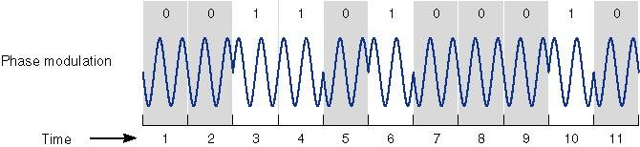
Phase Modulation
Phase of carrier signal is shifted to represent data
Differential PSK
  Phase shifted relative to previous transmission rather than some reference signal

